Slide 1
StarCraft Network
SYSM 6302 Project
Created by Swanand K. and Andrew R.
Contribution by and Special Thanks to “The Catniss,” Liquipedia, and Blizzard Entertainment

Slide 2
What is StarCraft?
StarCraft is a real-time strategy (RTS) computer game created by Blizzard Entertainment in 1998. The game revolves around a war fought between three species named Protoss, Terran, and Zerg. A player selects one of the three species to face off against another player who also selects one of the three species.
Picture Taken From: http://StarCraft.wikia.com/wiki/StarCraft
Intro
Conclusion
Questions
Graph Construction
Network Properties
Rivalry Detection

Slide 3
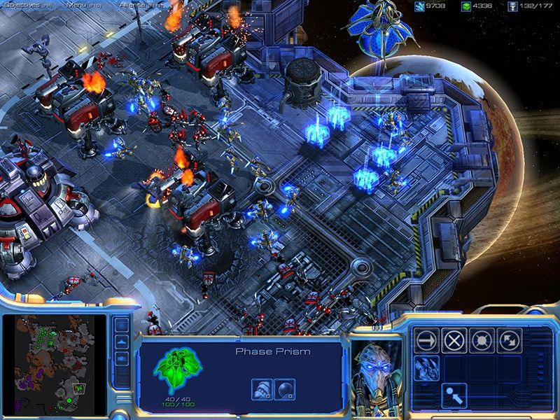
Typical Gameplay Snapshot
Taken From: https://blogs-images.forbes.com/johngaudiosi/files/2012/12/starcraft2.jpg
Intro
Conclusion
Questions
Graph Construction
Network Properties
Rivalry Detection

Slide 4
Data Source: Liquipedia Minor Tournaments
Minor Tournaments Included:
Legacy of The Void (2015-Present)
Heart Of the Swarm (2015)
Taken From: http://wiki.teamliquid.net/starcraft2/Minor_Tournaments
Intro
Conclusion
Questions
Graph Construction
Network Properties
Rivalry Detection

Slide 5
Selecting Data From Each Tournament
Minor Tournaments Included:
61 Total Pages Scraped
Taken From: http://wiki.teamliquid.net/starcraft2/Minor_Tournaments
Intro
Conclusion
Questions
Graph Construction
Network Properties
Rivalry Detection

Slide 6
What the Network looks like
Node Total: 752 Nodes
Edge Total: 2446 Edges
Legend
1
MaNa
Snute
Node
3
Player
1
2
Loss
Win
Win
Loss
1
2
MVP
Player
MarineKing
4
Intro
Conclusion
Questions
Graph Construction
Network Properties
Rivalry Detection

Slide 7
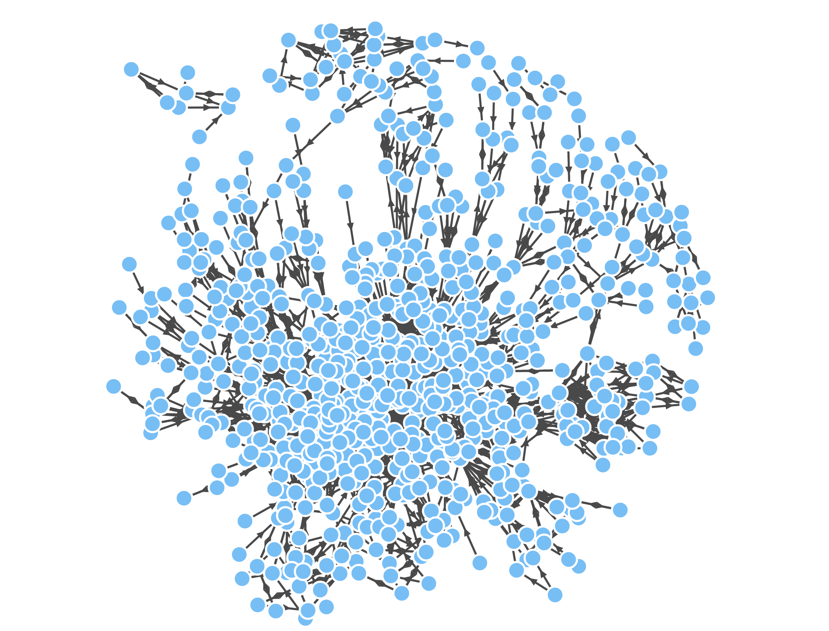
StarCraft Network
Node Total: 752 Nodes
Edge Total: 2446 Edges
Intro
Conclusion
Questions
Graph Construction
Network Properties
Rivalry Detection
Notes:
Thanks Andrew.
So, the StarCraft network…
This is the extent of our network- 752 nodes in total and 2446 edges. It’s a directed weighted network with edges in both directions for most of the node pairs-as Andrew just showed.

Slide 8
Network Measurements and Characteristics
Most wins
1. Nerchio (171.0000)
2. Bly (132.0000)
3. Kelazhur (98.0000)
4. Snute (96.0000)
5. Neeb (87.0000)
6. uThermal (78.0000)
7. MarineLorD (77.0000)
8. ByuN (74.0000)
9. Elazer (68.0000)
10. DaNa (66.0000)
Most Losses
1. Bly (120.0000)
2. Nerchio (69.0000)
3. Snute (67.0000)
4. Neeb (66.0000)
5. Kelazhur (59.0000)
6. MarineLorD (56.0000)
7. uThermal (55.0000)
8. DaNa (52.0000)
9. MaNa (51.0000)
10. Elazer (51.0000)
Most Successful(50 games minimum)
1. Serral (0.7595)
2. Reynor (0.7361)
3. Nerchio (0.7125)
4. ByuN (0.6981)
5. Solar (0.6957)
6. souL (0.6753)
7. GuMiho (0.6528)
8. iaguz (0.6415)
9. Cladorhiza (0.6333)
10. Kelazhur (0.6242)
Nerchio has got the most wins
Bly is the most active player
Number of games does not necessarily reflect into success
Intro
Conclusion
Questions
Graph Construction
Network Properties
Rivalry Detection
Notes:
We have performed a few centrality measures on our network. we found the players with most wins- as you can see- the player named ‘Nerchio’ tops this list with 171 wins, followed by Bly, Kelazhur and others.
Similarly we came up with a list of players with maximum losses- that is weight of the out-degree of a particular- and it’s seen Bly and Nerchio are the two biggest losers.
Talking about the success rate, i.e. who is the most successful player in the StarCraft for chosen tournament, one way to think about it could be- whoever has the most wins is the most successful. But it’s not completely correct- because if you see, the top two players with the most wins, Nerchio and Bly also top the list of ‘the biggest losers’. It indicates that they have played many more games relative to other players- so it’s natural for them to have the most wins. Hence, we came up with a success factor, now again, there are a few players who played only one game, won it and then left the tournament for some reason. So those players would have a success rate of 100%, which is not fair to the players who are consistently participating. So we decided 50 games as a minimum cut-off to decide a players success- and here is the result- Serral is the most successful player with 76% wins.
And interestingly, Nerchio comes third on the list, and Bly is not even in top 10.
By the way, we have had done similar analysis for the bottom ten players- wins, success etc., but the results are not interesting enough to present.

Slide 9
Network Measurements and Characteristics
Eigenvector centrality
1. Nerchio (0.5399)
2. ByuN (0.2937)
3. uThermal (0.2865)
4. Neeb (0.2485)
5. Elazer (0.2176)
6. Solar (0.2170)
7. Snute (0.2146)
8. Bly (0.2002)
9. Polt (0.1773)
10. Kelazhur (0.1637)
Kat’z centrality (blew off at alpha = 1)
Traceback (most recent call last):
File "tests.py", line 145, in <module>
f2 = la.inv(f1)
File "C:\Python27\lib\site-packages\numpy\linalg\linalg.py", line 526, in inv
ainv = _umath_linalg.inv(a, signature=signature, extobj=extobj)
File "C:\Python27\lib\site-packages\numpy\linalg\linalg.py", line 90, in _rais
e_linalgerror_singular
raise LinAlgError("Singular matrix")
numpy.linalg.linalg.LinAlgError: Singular matrix
Nerchio- most central player based on eigenvector centrality
Kat’z centrality- failed for alpha =1 (shows why PageRank is a better measurement)
Number of games does not necessarily reflect into success
Intro
Conclusion
Questions
Graph Construction
Network Properties
Rivalry Detection
Notes:
So, similarly, we did the eigen vector centrality computations and Nerchio turned out to be the most central player.
Also, there was an interesting result to observe- Kat’z centrality, for alpha = 1, we got this error- that (I-alpha*A) was a singular matrix and we can not compute it’s inverse. So it was quite fascinating to observe it pragmatically what we learnt in class- Katz centrality may blow off for some alpha values if determinant of I-alpha*A = 0, which stresses the fact for using the PageRank centrality measures.

Slide 10
Network Measurements and Characteristics
Kat’z centrality, alpha =20
1. Proch (108996960.8759)
2. Sorry (97910008.7652)
3. Blooddrop (75095678.401
4. BabyMarine (38802576.08
5. Destiny (20818206.2792)
6. ByuL (14876622.5891)
7. ImmortalPasT (12315901.
8. VortiX (11947522.4123)
9. JieShi (11395691.2708)
10. Dear (10701537.3876)
PageRank centrality, alpha =0.85
1. Nerchio (130.3691)
2. Bly (84.1662)
3. Snute (80.3277)
4. ByuN (70.8134)
5. uThermal (68.2051)
6. Neeb (61.0429)
7. Solar (58.7474)
8. Kelazhur (56.7222)
9. Arnovic (56.6939)
10. MarineLorD (51.0601)
Betweenness centrality
1. Nerchio (0.0496)
2. Lillekanin (0.0481
3. Snute (0.0473)
4. Bly (0.0462)
5. Spazymazy (0.0454)
6. Aicy (0.0447)
7. Reynor (0.0438)
8. Kelazhur (0.0421)
9. Bunny (0.0402)
10. Semper (0.0369)
Nerchio- “Veteran” of StarCraft games
Intro
Conclusion
Questions
Graph Construction
Network Properties
Rivalry Detection
Notes:
So, here are some more results- Katz centrality at alpha =20, Page rank centrality at alpha= 0.85, the Google’s alpha and he between ness centrality. So as we have seen through all these centrality measures, Nerchio does dominate- which is not that ground breaking since he is the most active player. So we call him the “Veteran” of the StarCraft games.

Slide 11
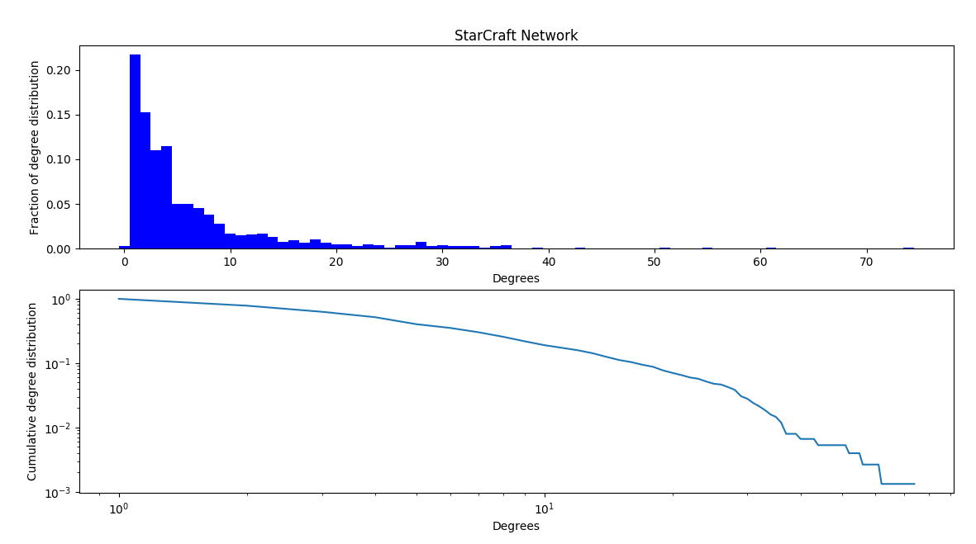
Network Measurements and Characteristics
Scale free behavior
Kmin = 6, Alpha = 2.32 (‘Total degree’ follows Power law)
Few players make most chunk of the tournament, matches with the fact that top 25% players played 72% of the matches
Average degree of node =6, Average degree of neighbors = 18.11 (Friendship paradox)
Intro
Conclusion
Questions
Graph Construction
Network Properties
Rivalry Detection
Notes:
So these are the results for the degree distribution of our network- it follows a power law, with alpha = 2.32. it’s with respect to the total degrees- so we conclude that there are a few players who have played most games. Check 20-80 behavior. Not quite the 20-80 rule, but still close- 25-72..
Also, the friendship paradox results are these- Average degree of node =6, Average degree of neighbors = 18.11.

Slide 12
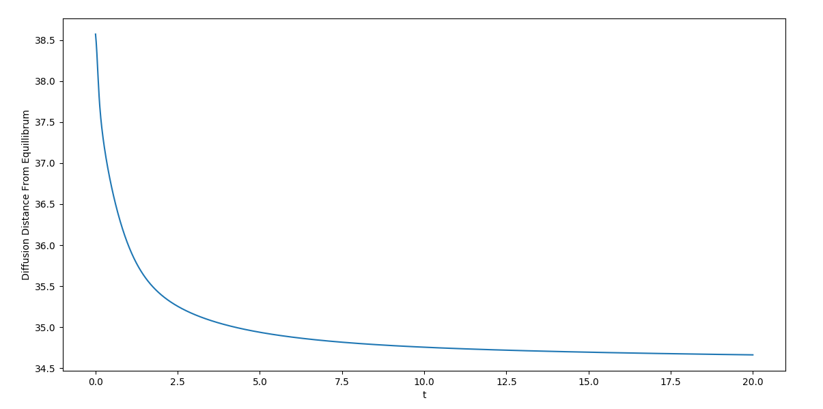
Network Measurements and Characteristics
Diffusion of an innovative game plan
Nerchio came up with a ‘master innovative move’ to increase his success rate
Takes 200 ‘game-steps’ to ‘generalize’ the move
Not all players learn it- though Nerchio is the ‘most-between’ player
Intro
Conclusion
Questions
Graph Construction
Network Properties
Rivalry Detection
Notes:
Now we consider a case here- we saw how Nerchio is the most central player with most wins, dominates most of the analyses but he is not the most successful player- and that hurts him real bad. So, he gets his thinking hat ON, works hard and comes with an innovative game strategy. So, as he starts using this new game plan, it’s obvious that other players will also slowly start learning his tactics, slowly but surely. So we modeled this as a diffusion of the idea through the network as he plays his opponents- It would take 200 game steps- which means 200 time instances for this move to diffuse through the network. Still as we see, it will probably be never be the case that “each player” learns the trick- which supports the fact– Chinese player???????????????????????

Slide 13
Network Measurements and Characteristics
Mixing of network
Modularity based on number of games of played- grouping done accordingly
Two groups-
<50 games, >= 50 games -- Modularity: 0.1216 / 0.4482
<50, 50-99, 100-149and <149 games -- Modularity: 0.0795 / 0.5084
Assortative mixing
Intro
Conclusion
Questions
Graph Construction
Network Properties
Rivalry Detection
Notes:
We also tried to find the mixing in our network based on modularity- groups were formed by number of games played by the nodes.
Results- <50 games, >= 50 games -- Modularity: 0.1216 / 0.4482
<50, 50-99, 100-149and <149 games -- Modularity: 0.0795 / 0.5084
so it shows Assortative mixing in the network.

Slide 14
Using Co-citation To Identify Potential/Unknown Rivals
Using Co-citation: Identify potential rivalries and “good” matches for players who have never played each other. An assumption is made that the weight of two players in a Co-citation matrix is a strong indicator that two nodes/players who have never played each other will generate good matches and may be potential/unknown rivals.
Co-citation Strength Between Two Players
['Snute', 'Nerchio', 250.0]
['Nerchio', 'Solar', 227.0]
['uThermal', 'Polt', 189.0]
['souL', 'Tefel', 189.0]
['Neeb', 'uThermal', 175.0]
['Nerchio', 'Tefel', 166.0]
['DnS', 'PtitDrogo', 152.0]
['Bly', 'ByuN', 150.0]
['MaSa', 'Kelazhur', 149.0],
['MarineLorD', 'ShaDoWn', 145.0]
Player A
Player B
These players have never had a match together.
Intro
Conclusion
Questions
Graph Construction
Network Properties
Rivalry Detection

Slide 15
Using Graphlets to Identify Potential/Unknown Rivals
Using Graphlets: Identify potential rivalries and “good” matches for players who have never played each other. An assumption is made that the number of matches between neighbors of neighbors is a strong indicator that two nodes/players who have never played each other will generate good matches and may be potential/unknown rivals.
Two Node Graphlets: 728
[['Nerchio', 'Elazer', 28.0]
['PtitDrogo', 'MarineLorD', 27.0]
['Nerchio', 'uThermal', 25.0]
['souL', 'DaNa', 21.0]
['Snute', 'uThermal', 18.0]
['Neeb', 'MaSa', 18.0]
['DnS', 'Dayshi', 18.0]
['Lilbow', 'ShaDoWn', 18.0]
['Neeb', 'Scarlett', 18.0]
['Lilbow', 'MarineLorD', 17.0]]
Three Node Graphlet: 3134
['MaNa', 'Nerchio', 'Elazer', 43.0]
['MaNa', 'Nerchio', 'uThermal', 40.0]
['PtitDrogo', 'MarineLorD', 'DnS', 39.0]
['Elazer', 'Nerchio', 'Guru', 37.0]
['DaNa', 'Nerchio', 'uThermal', 36.0]
['PtitDrogo', 'MarineLorD', 'Denver', 35.0]
['DaNa', 'souL', 'Basior', 35.0]
['Neeb', 'Nerchio', 'uThermal', 34.0]
['Strange', 'Elazer', 'Nerchio', 34.0]
['Snute', 'Elazer', 'Nerchio', 33.0]
Intro
Conclusion
Questions
Graph Construction
Network Properties
Rivalry Detection

Slide 16
Using Graphlets to Identify Potential Rivals
3 Node, Triangle Graphlets: 180
['Lilbow', 'PtitDrogo', 'MarineLorD', 52.0]
['Harstem', 'Nerchio', 'uThermal', 49.0]
['PtitDrogo', 'MarineLorD', 'Dayshi', 48.0]
['Nerchio', 'DaNa', 'Elazer', 47.0]
['ArT', 'souL', 'DaNa', 41.0]
['Happy', 'Nerchio', 'Elazer', 41.0]
['Bly', 'Nerchio', 'uThermal', 40.0]
['Rodzyn', 'ArT', 'DaNa', 39.0]
['DnS', 'MarineLorD', 'Dayshi', 39.0]
['Bly', 'Nerchio', 'Elazer', 38.0]
Four Node, Square Graphlet: 200
['PtitDrogo', 'MarineLorD', 'DnS', 'ShaDoWn', 59.0]
['Bunny', 'ByuN', 'Nerchio', 'Elazer', 53.0]
['HeRoMaRinE', 'MaNa', 'Nerchio', 'uThermal', 49.0]
['Elazer', 'Nerchio', 'Neeb', 'Bunny', 49.0]
['Neeb', 'Nerchio', 'uThermal', 'Beastyqt', 46.0]
['Elazer', 'Nerchio', 'Kelazhur', 'Bunny', 45.0]
['Bunny', 'Lilbow', 'Nerchio', 'Elazer', 44.0]
['ByuN', 'Neeb', 'MaSa', 'viOLet', 40.0]
['JonSnow', 'Kelazhur', 'Neeb', 'MaSa', 38.0]
['DIMAGA', 'Strange', 'Nerchio', 'Elazer', 36.0]
Intro
Conclusion
Questions
Graph Construction
Network Properties
Rivalry Detection

Slide 17
Using Graphlets to Identify Potential Rivals
Five Node, “Star” Graphlet: 196
Set # | Node A | Node B | Node C | Node D | Node E | Total Matches | Triangle Weight | Node 'A' Wins | Node 'E' Wins
1 | souL | Rodzyn | Elazer | DaNa | Nerchio | 78 | 26 | 21 | 31
2 | Snute | uThermal | Bly | Nerchio | Kelazhur | 61 | 40 | 12 | 9
3 | Scarlett | Bly | Neeb | Kelazhur | Nerchio | 60 | 29 | 17 | 14
4 | FireCake | DnS | Denver | Dayshi | MarineLorD | 59 | 29 | 10 | 20
5 | souL | Rodzyn | Nerchio | DaNa | Guru | 57 | 27 | 15 | 15
6 | Scarlett | Neeb | Bly | MaSa | Kelazhur | 57 | 30 | 14 | 13
7 | Miszu | ArT | SouL | DaNa | Guru | 56 | 41 | 3 | 12
8 | uThermal | Bly | Neeb | Kelazhur | Nerchio | 56 | 29 | 13 | 14
9 | Polt | Bly | Neeb | Kelazhur | Nerchio | 56 | 29 | 13 | 14
10 | NaNa | SouL | Nerchio | DaNa | Guru | 56 | 40 | 5 | 11
If such a graph ‘A’ exists, count ‘B.’
B
B
A
E
A
E
C
D
C
D
Intro
Conclusion
Questions
Graph Construction
Network Properties
Rivalry Detection

Slide 18
Conclusion
Co-citation may prove to be useful to identify unknown rivalries and or good matches between player who have never played each other.
Rivalries in groups or small groups may be identified by evaluating graphlets.
Combining Co-citation and small group graphlet results may better solidify the accuracy of the rivalry prediction/detection. More work is needed in order to verify the accuracy of the results.
The StarCraft network is a scale free network.
Diffusion may help idntify how long a new strategy will be effective in a network.
Intro
Conclusion
Questions
Graph Construction
Network Properties
Rivalry Detection

Slide 19
Questions?
SYSM 6302 Project
Intro
Conclusion
Questions
Graph Construction
Network Properties
Rivalry Detection

Slide 20
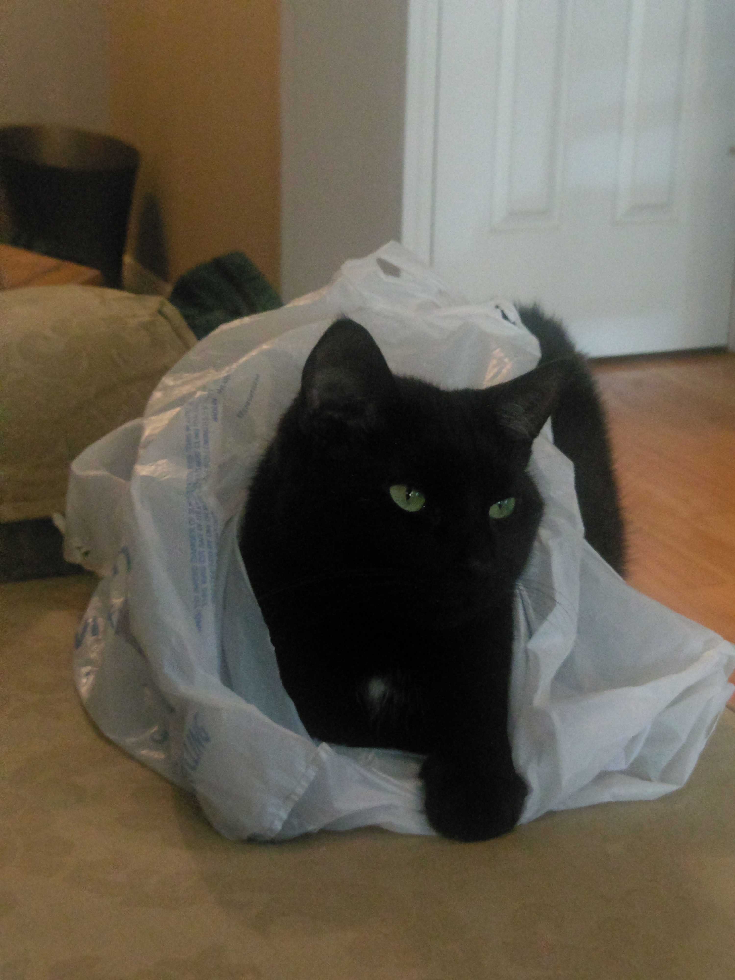
Special Thanks To Our Python Programmer
The Catniss

